Slide 1
EDIT HERE, THEN RUN SCRIPT, THEN SAVE A COPY OF THE ONE SLIDE
Notes:
https://api.weather.gov/alerts?zone=AKZ019
https://www.weather.gov/documentation/services-web-api#/default/alerts_query

Slide 2
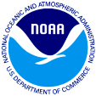
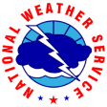
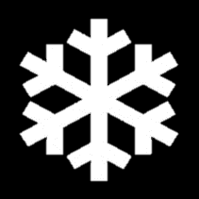
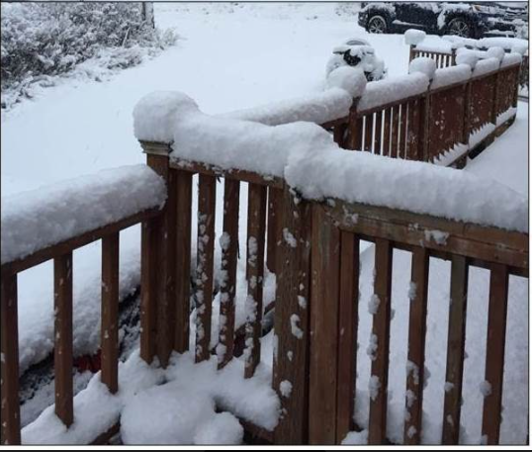
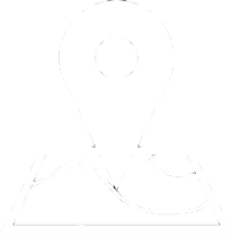
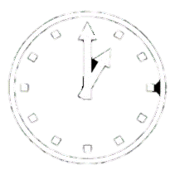
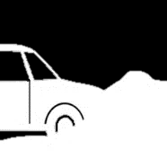

Winter Storm Warning
Threat Information
Issued: 02/10/2022 2:45 PM AKST
WHAT...Heavy snow expected. Total snow accumulations of 4 to 7 inches.
ADDITIONAL DETAILS...A transition to rain is expected midday Friday with up to an inch of rain after that point. This could make snow removal difficult and make icy conditions on compacted snow.
WHERE...Northeast Gulf Coast including Yakutat.
WHEN...From midnight tonight to noon AKST Friday.
Impacts
IMPACTS...Travel could be very difficult. The hazardous conditions could impact the morning commute.
National Weather Service | Juneau, AK |
weather.gov/juneau

Slide 3
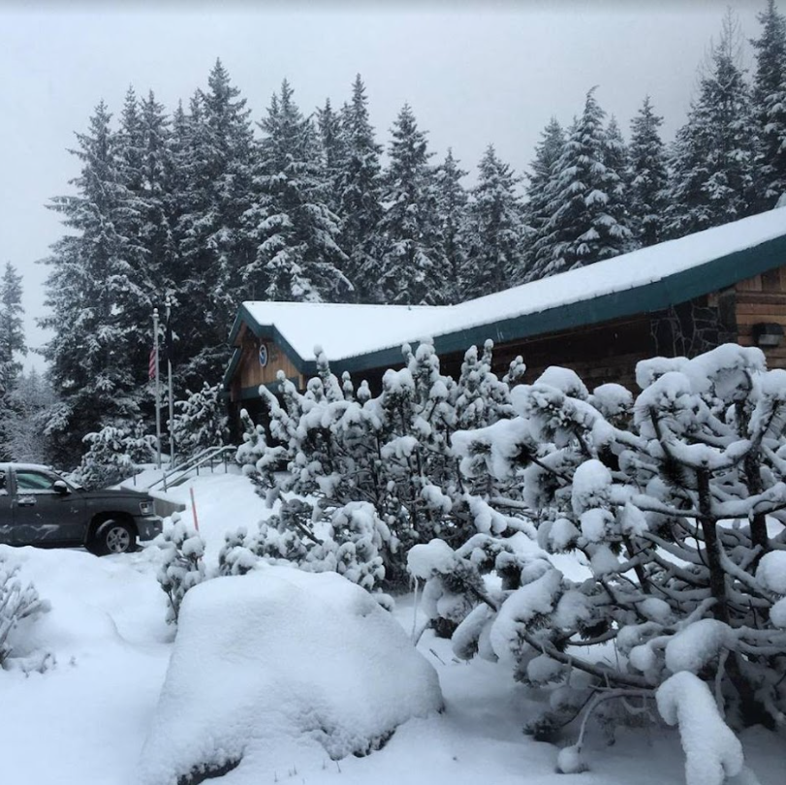
Winter Storm Watch
What To Expect
Issued: 09/08/2022 8:41 AM AKDT
WHAT...Southeast winds 50 mph with gusts 60 to 70 mph.
Insert graphic or image
ADDITIONAL DETAILS...The strongest winds are expected this afternoon through tonight. Winds will decrease Friday afternoon.
WHERE...From Delta Junction south.
WHEN...From 4 AM Thursday to 4 PM AKDT Friday.
Impacts
IMPACTS...Damaging winds could blow down trees and power lines. Power outages are possible. Travel could be difficult, especially for high profile vehicles. Unsecured objects could blow away.
National Weather Service | Juneau, AK |
weather.gov/juneau

Slide 4
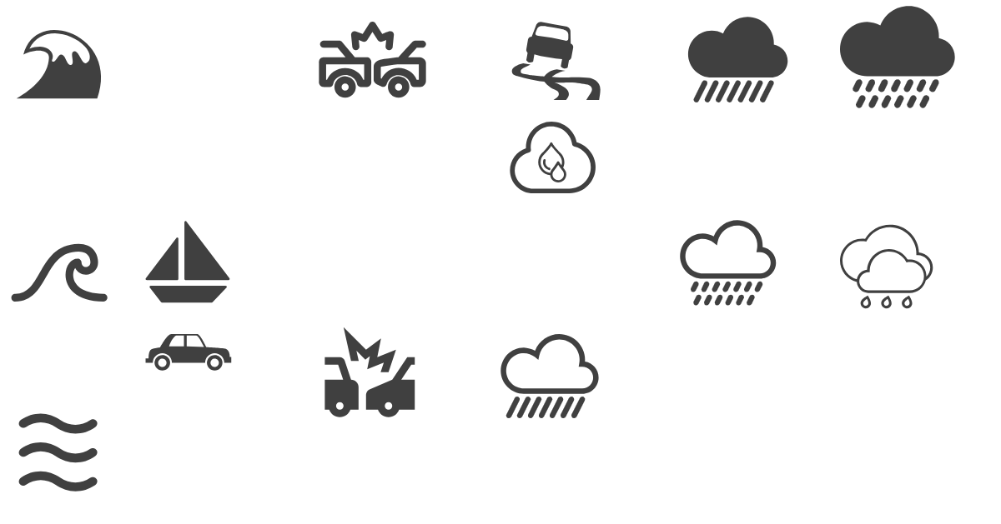
Winter Weather Advisory
What To Expect
Issued: 02/07/2022 10:36 AM AKST
WHAT...South winds 30 to 40 mph with gusts up to 60 mph expected.
Insert graphic or image
ADDITIONAL DETAILS...Greatest snowfall expected beyond 6 mile Monday evening, then snow levels rising to 2000 feet Tuesday afternoon. Near sea level, some mixing with snow is possible Monday evening, otherwise rain is expected.
WHERE...Skagway.
WHEN...From 3 PM this afternoon to 6 AM AKST Thursday.
Main Concerns
IMPACTS...Damaging winds may blow down trees and power lines. Travel will be difficult, especially for high profile vehicles.
National Weather Service | Juneau, AK |
weather.gov/juneau

Slide 5
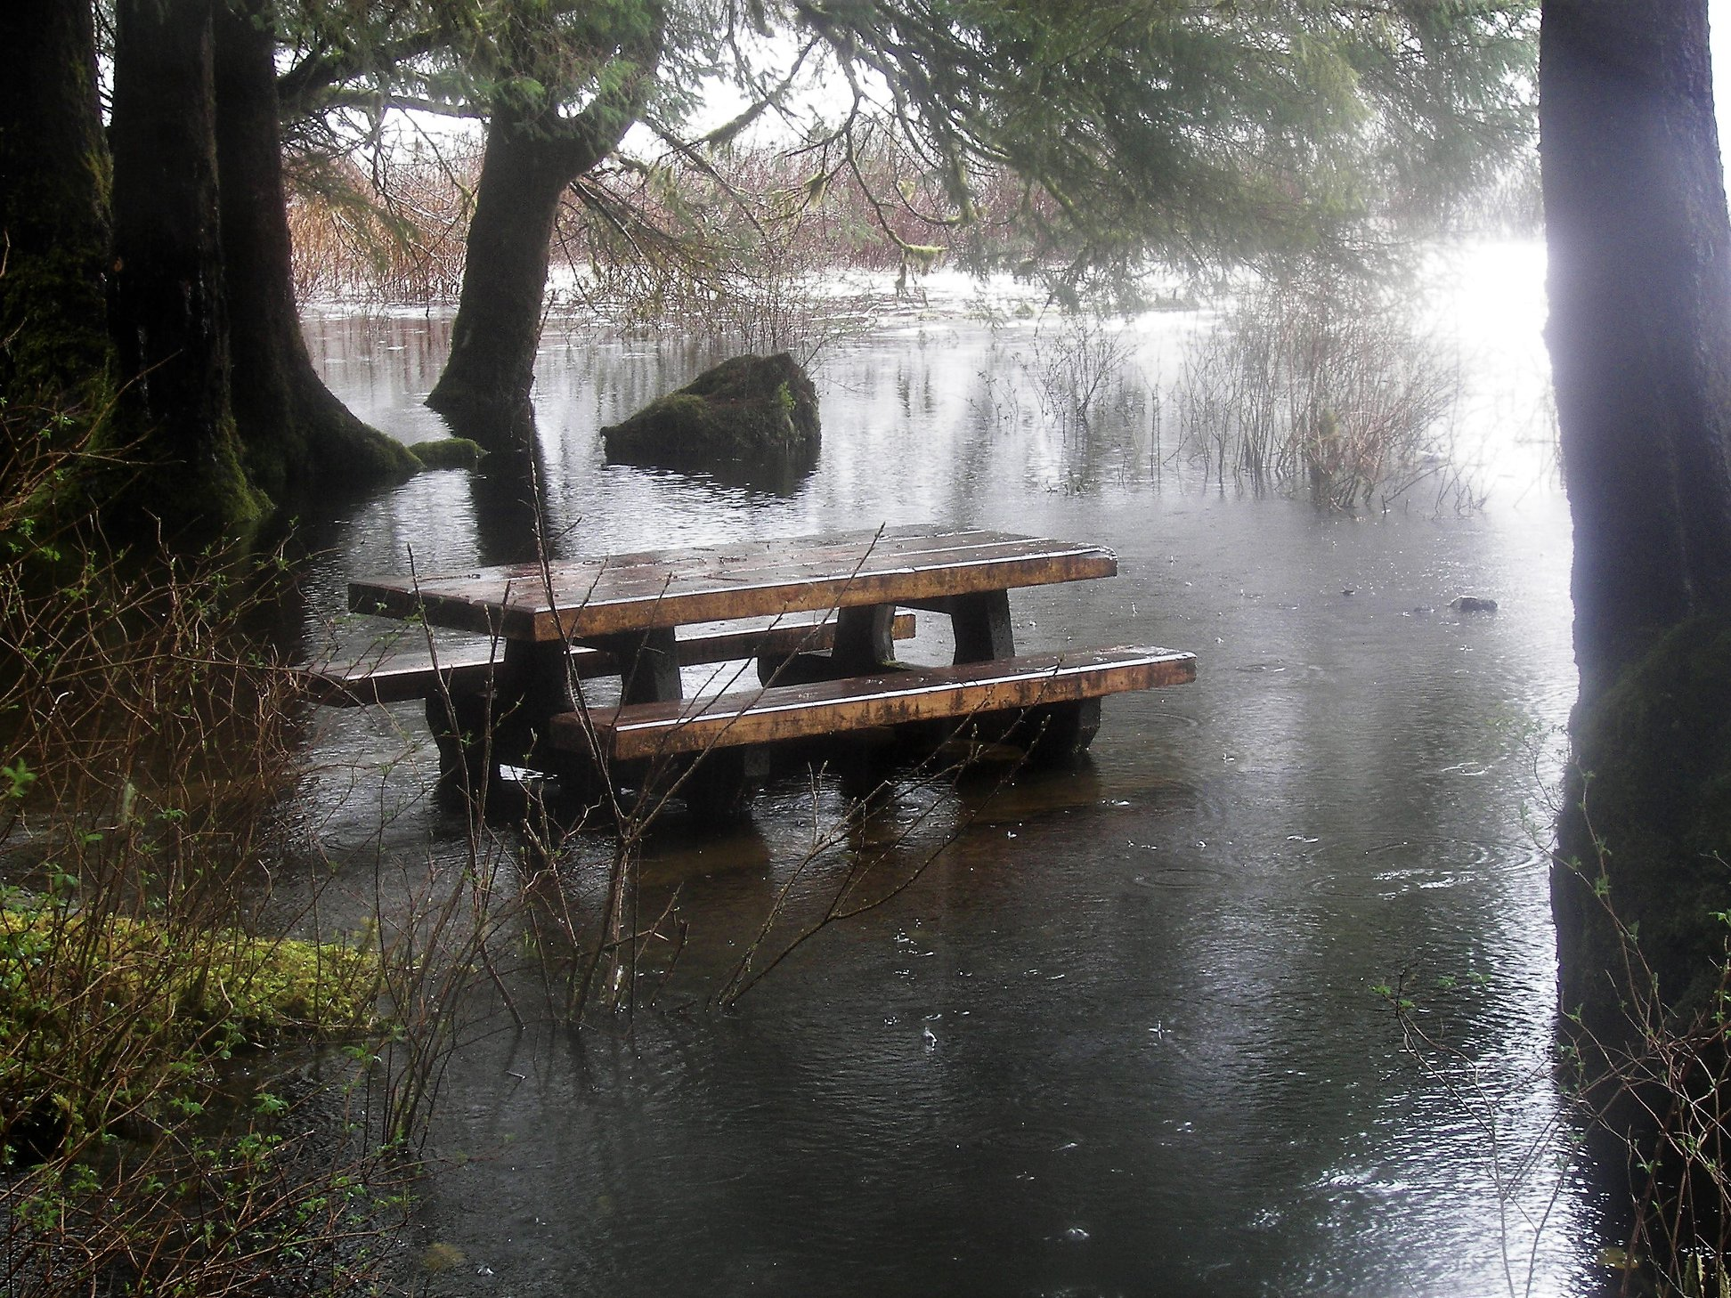
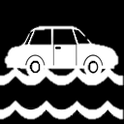
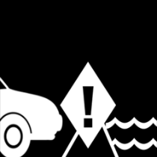
Flood Advisory
Ward Lake near Ketchikan
Issued: 12/12/2021 9:19 PM AKST
Threat Information
Insert graphic or image
Impacts
National Weather Service | Juneau, AK |
weather.gov/juneau

